Slide 1
Topological Quantum Computation with Gapped Boundaries
Iris Cong
Dept. of Computer Science, UCLA
Jointly authored with Prof. Zhenghan Wang (advisor) and Meng Cheng
arXiv:1609.02037

Slide 2
Contents
Introduction
Part I: Hamiltonian Realization
Part II: Algebraic Theory
Part III: Universal Topological Quantum Computation
Notes:
Part I: Lattice based, exactly solvable Hamiltonian
Part II: Category theory, but won’t go into detail for this talk
Part III: Use this for universal TQC

Slide 3
Introduction
Topological quantum computation (TQC): encode information in topological degrees of freedom of quantum systems
  Prevent susceptibility of qubits to local decoherence
Traditionally: anyons in (bulk of) topological phases of matter
  Ground state degeneracy → qubit encoding; braiding → gates
What happens when we study TQC in the context of boundaries of topological phases?

Slide 4


Introduction
A topological phase of matter is an equivalence class of gapped Hamiltonians that realize a topological quantum field theory (TQFT) at low energy
A gapped boundary is an equivalence class of gapped local (commuting) extensions of to the boundary

Slide 5
Previous Works
Kitaev (1997)
Bombin and Martin-Delgado (2008)
Beigi, Shor, Whalen (2011)
Kitaev and Kong (2012)
Fowler, Mariantoni, Martinis, Cleland (2012)
Barkeshli and Freedman (2016)
…
Notes:
Kitaev: original lattice Hamiltonian for DW theory in the bulk
Bombin and Martin-Delgado: modification of Kitaev’s Hamiltonian
BSW + KK: both construct certain gapped boundary Hamiltonians
Fowler: TQC on surface codes
BF: Introduced topological charge projection that we adapt for universality

Slide 6
Part I: Hamiltonian Realization of Gapped Boundaries

Slide 7
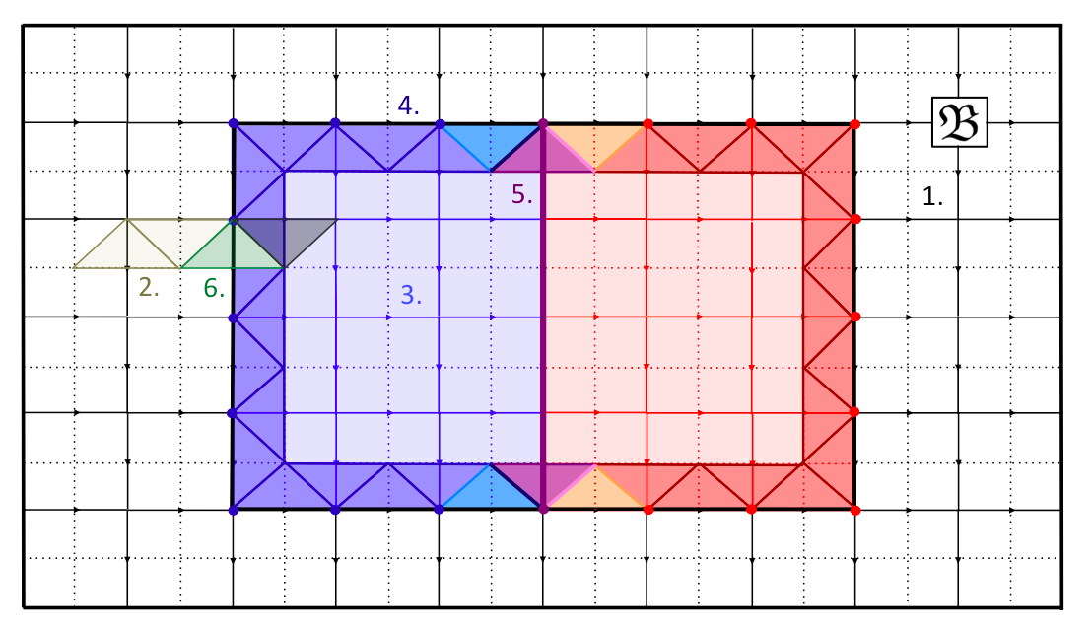
Overview: Parts I and II
Parts I and II: Hamiltonian Realization and Algebraic Theory
Notes:
Esp. for first two parts, would like to emphasize the importance of each part of the lattice
[Distribute sheets]
Used numbers to indicate the most important aspects (e.g. bulk lattice, hole lattice, or triangles/ribbons)

Slide 8
Part I: Overview
Review Kitaev quantum double model: Hamiltonian, ribbon operators, and elementary excitations (1, 2)
Hamiltonian, ribbon operators, and elementary excitations for quantum double model with boundary (3, 4)
Hamiltonian for defects between boundaries (5)
Condensation, ground state degeneracy (GSD), and qudit encoding (6)

Slide 9


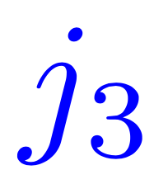
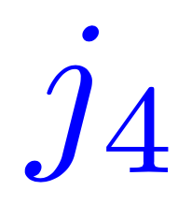

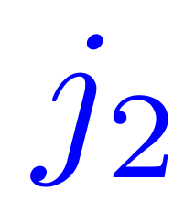
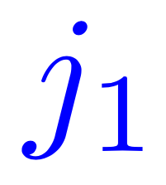

Kitaev Quantum Double Models (1)
(Square) lattice, each edge a qudit (spin) from the Hilbert space with orthonormal basis
Goal: define local commuting Hamiltonian
Notes:
Need a directed lattice in the case that G is non-abelian

Slide 10
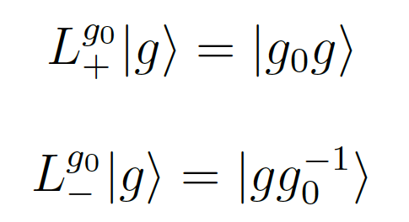
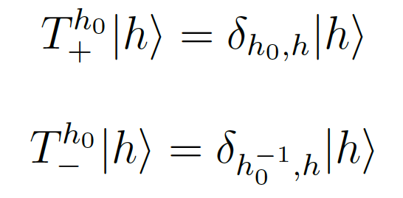
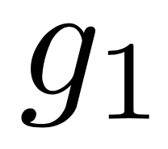
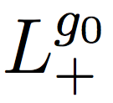

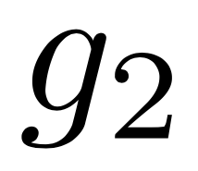
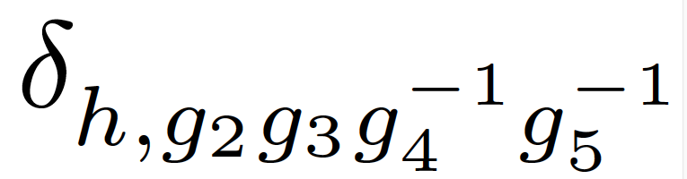
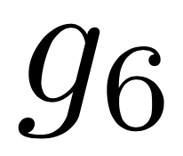
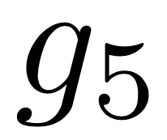
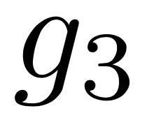
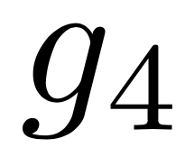
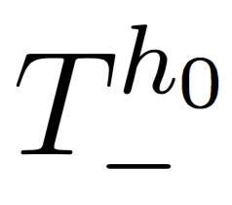
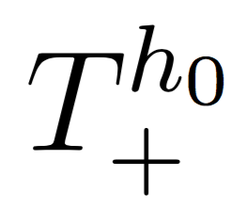
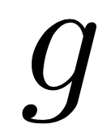
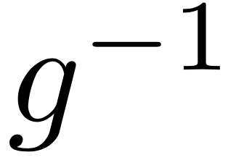
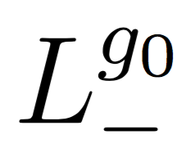
Kitaev Quantum Double Models (1)
Local operators:
  L: multiplication
  T: comultiplication
Plaquette and vertex operators:
Local operator algebra (quantum double):
Notes:
L,T act on single qudit/spin
B^h projects onto flux h, linear combination of products of T’s
A^g’s form representation of G, product of L’s
If you pay close attention: Whenever used in the context of vertices/plaquettes, +/- picked by the arrow

Slide 11
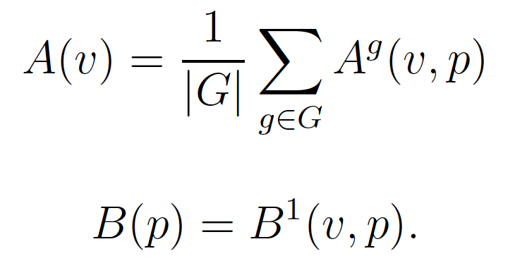
Kitaev Quantum Double Models (1)
Local operators (Cont’d):
  A(v) projects onto trivial representation
  B(p) projects onto trivial flux
Hamiltonian (local and commuting):
Excited states of the Hamiltonian?
Notes:
A(v) project onto trivial representation, B(p) onto trivial flux (dual space)
(Duality: A(v) = linear combination of product of L, B(p) = linear combination of product of T)
Note generalization to cases with 3-cocycles

Slide 12
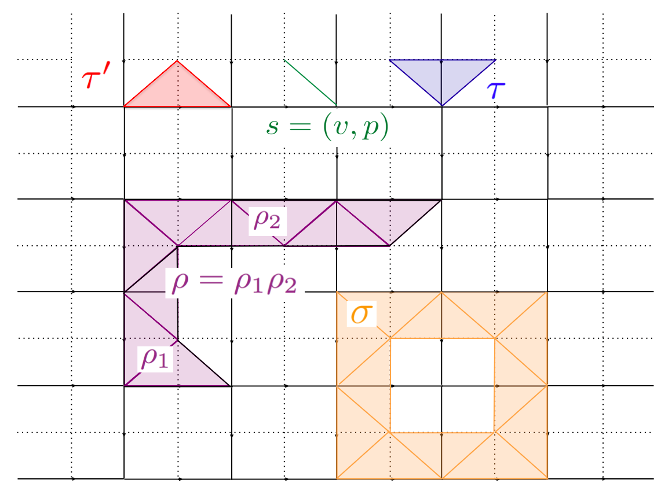
Ribbon Operators (2)
Some notation:
  Two lattices
  s = (v,p) is a cilium
  τ’ is a direct triangle
  τ is a dual triangle
  ρ = ρ₁ρ₂ is an open ribbon
  σ is a closed ribbon
Notes:
Ribbon: glue together triangles, alternating direct and dual

Slide 13
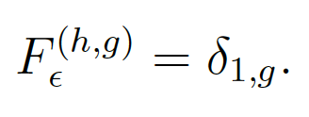

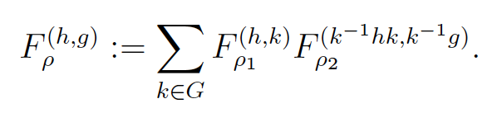
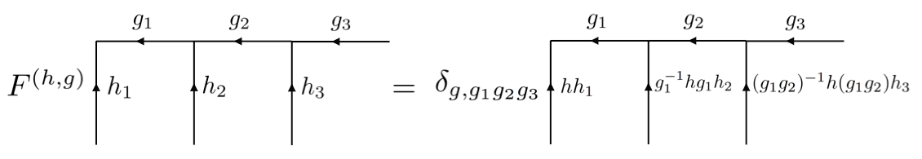
Ribbon Operators (2)
Recursive definition (ε = empty, τ = dual, τ’ = direct):
Diagrammatically,
Ribbon operators create arbitrary excitations at the two ends
Notes:
Diagrammatic definition is a special case of triangles (triangles must come in direct/dual pairs, even #)

Slide 14
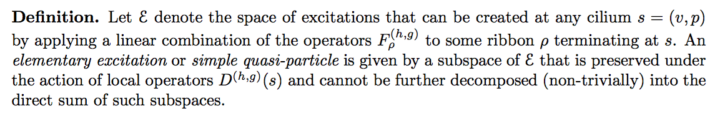
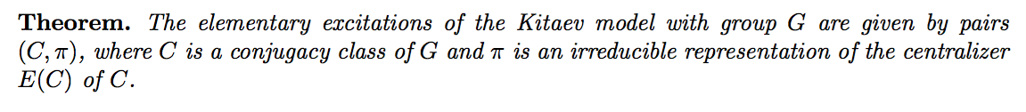
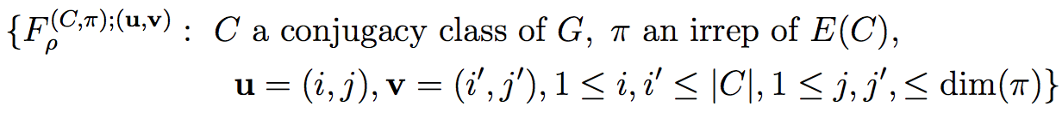
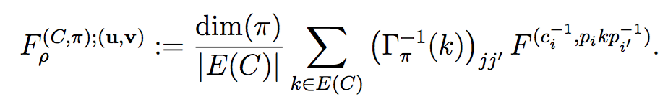
Elementary Excitations (2)
* These elementary excitations are hence “topological” and hence have “topological charges”
Sketch of Proof: Fourier transform on operator algebra to new basis:
Notes:
Ribbon operators generate a space of excitations, “elementary excitations” are subspaces invariant under local operators D defined previously
Topological vs. local degrees of freedom: action on ends of the ribbon by D^(h,g)
Fourier transform on the operator algebra, not on vectors themselves
QUANTUM DIMENSION

Slide 15
Example: G = Z₂ (Toric Code)
Notes:
Kitaev’s famous toric code, standard qubit on each edge, vertex/plaquette operators are Paulis [do the example]
Remark: very similar for Z_p, any prime p
Note: abelian groups → all have quantum dimension 1 (“abelian anyons”)
On a surface with trivial topology (e.g. plane, sphere, easy to realize physically) no interesting degeneracy or braiding for TQC
Non-abelian groups → higher quantum dimension (“non-abelian anyons”) → give degeneracy and braiding
e.g. S_3, symmetric group on set of 3 elements → Cui et al. universal. See also analysis in paper

Slide 16
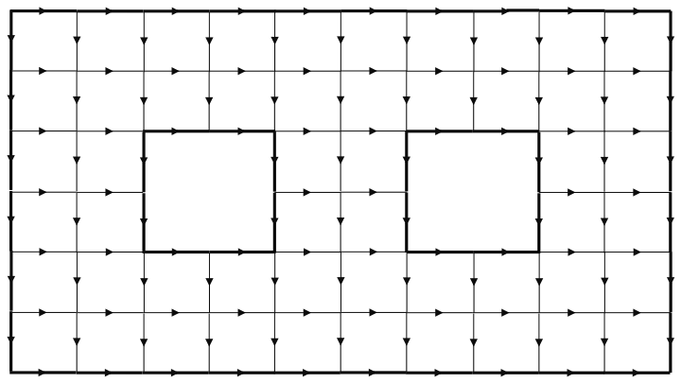
Kitaev Models with Boundary
In general, gapped boundary type given by a subgroup K of G up to conjugation, and a 2-cocycle of K
Notes:
Approach: First describe what happens in the holes, then combine with the bulk
We consider the case where the cocycle is trivial, the generalization is not difficult

Slide 17
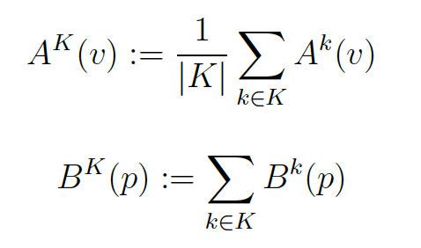
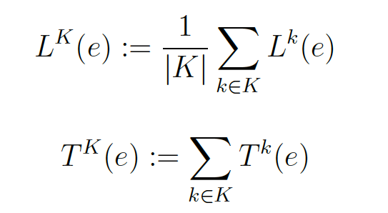
“Hole” Hamiltonian (3)
Define new vertex, plaquette, edge terms (Bombin and Martin-Delgado, 2008):
Hamiltonian (local and commuting):
Notes:
A^K projects to trivial representation when restricted to K
B^K projects to flux in K
Reminder: L,T are multiplication/comultiplication from before
L^K, T^K serve as string tension terms, break the gauge symmetry (completely broken in interior)
QUDITS ARE ALL STILL FROM GROUP G
Note generalization to cases with 2-cocycles

Slide 18
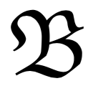
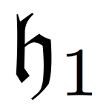
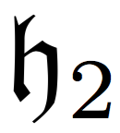
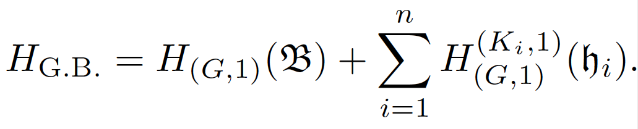
Gapped Boundary Hamiltonian (4)
Kitaev model with boundary: Lattice + holes
Hamiltonian:
Notes:
NOTE: vertices are within the hole, but edges are not!!!

Slide 19
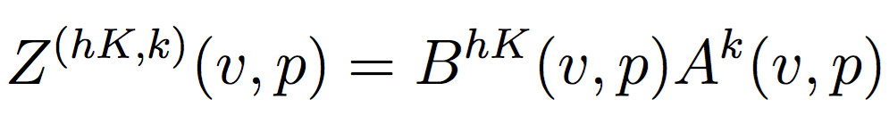
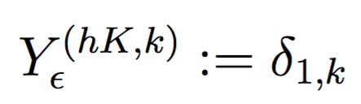
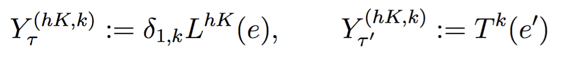
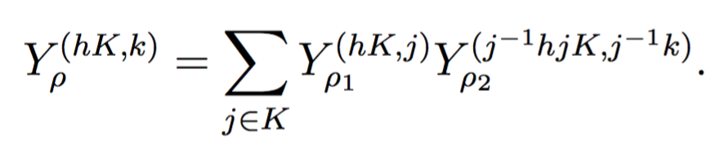
Boundary Local/Ribbon Operators (4)
Local operators:
Ribbon operators:
  Act on “boundary” (darker) ribbon
Notes:
B^hK: project into left coset
Note: only |G| local operators now, instead of |G|^2 as before → some original local degrees of freedom now protected by boundary
(L^hK: sum over left coset)
Diagrammatic picture is not as nice as before, not presented here

Slide 20
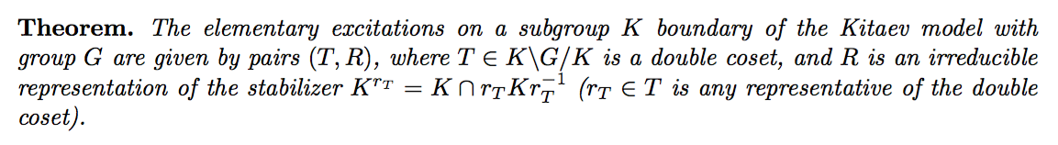
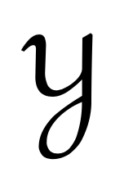
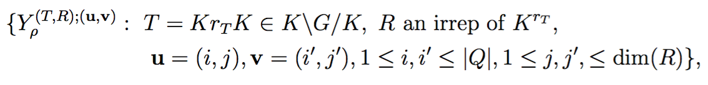
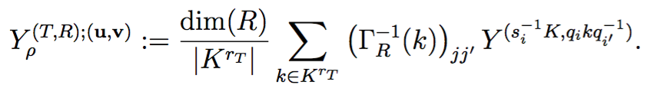
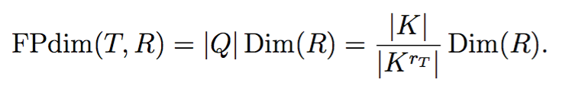
Boundary Elementary Excitations (4)
Sketch of Proof: Like before, Fourier transform on operator algebra to new basis:
Quantum dimensions:
Notes:
Topological vs local degrees of freedom
These excitations are confined: # non-commuting instances proportional to length of ribbon along which particle is moved

Slide 21


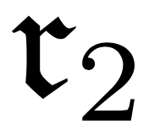
Boundary Defects (5)
Two boundary regions given by subgroups K₁, K₂, defects = dividing cilia
Hamiltonian (local and commuting):
Notes:
Defect lives on the two cilia
Again, divide into different parts of lattice

Slide 22
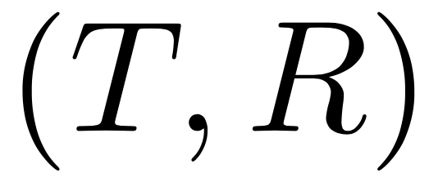
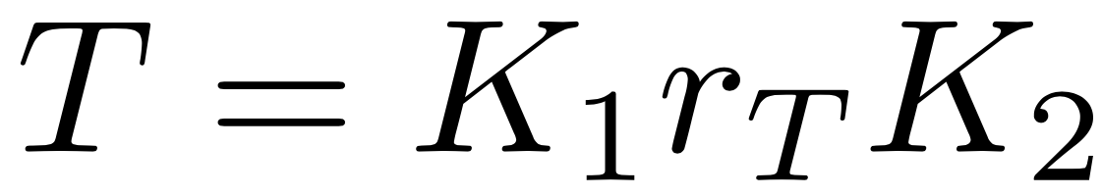
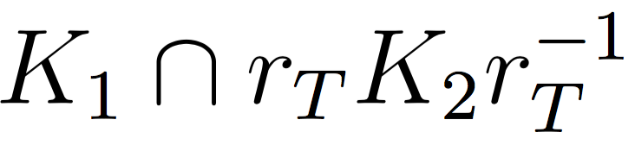
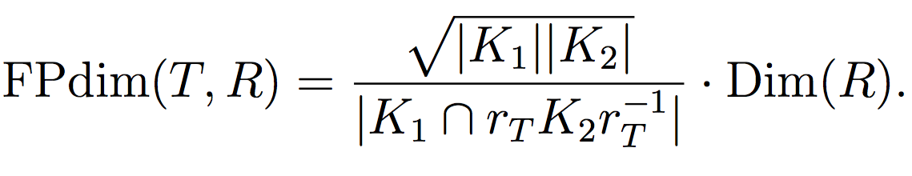
Boundary Defects (5)
Write down ribbon operators as before
Simple defect types parameterized by , a double coset, an irreducible representation of
Quantum dimension:
Notes:
Due to confinement of particles in hole, typically only practical to consider r_T = 1, R = trivial

Slide 23



Boundary Defects: Examples
Example: Boundary defects in and behave like Majorana and para-fermion zero modes
Example: Boundary defects in
  Topological properties like genons (Barkeshli/Jian/Qi, 2013)

Slide 24




Condensation and GSD (6)
Condensation: elementary excitation in bulk → push into boundary → non-elementary in boundary, decomposes
  Simple formula to calculate the resulting elementary boundary excitations (see Sec. 2.5)
Ground state degeneracy (GSD):
  Certain operators commute with Hamiltonian
  Equivalent to condensing to vacuum
Notes:
Non-elementary because you have less basis operators
Not presented here, in backup slides

Slide 25

Qudit Encoding
The commuting ribbon operators (“tunneling operators”) acting on ground state:

Slide 26



Condensation Products (6)
Notes:
Recall pi is irrep of E(C), R of stabilizer → both restrict to intersection
Note on condensation multiplicities: number local degrees of freedom in bd < in bulk, remaining
local degrees become condensation multiplicites (in some way, like fusion multiplicity)
Note: quantum dimension of LHS, RHS equal

Slide 27

Inverse Condensation Products (6)
Notes:
Important: the ones that can condense to vacuum determine the gapped boundary!!

Slide 28
Example: G = Z₂ (Toric Code)
Example: Toric code gapped boundaries, elementary excitations

Slide 29
Part II: Algebraic Theory of Gapped Boundaries
Notes:
Will not go into detail (due to time), but provide a summary. If anyone’s interested please see Chapter 3

Slide 30






Summary of Algebraic Model
Bulk: Topological order given by Drinfeld center , a unitary fusion category (1, 2)
  is a modular tensor category, anyons are simple objects
Gapped boundaries are indecomposable modules of , or equivalently, Lagrangian algebras in (3)
Boundary excitations: objects in (4)
Defects between boundaries: objects in (5)
Condensation is a tensor functor (6)
Notes:
Our previous cases: C is representation category of a finite group G (special case). Generalizing G to weak/quasi Hopf algebra gives most general
Elementary excitations, simple defects are simple objects in functor category

Slide 31






Qudit Encoding
Algebraic model of qudit encoding (abstract away details of lattice and Hamiltonian):
Notes:
Two holes in the plane, total charge vacuum

Slide 32
Part III: Topological Quantum Computation

Slide 33
Part III: Overview
Tunnel-a operations
Braiding gapped boundaries
Topological charge measurement
Universal topological quantum computation

Slide 34

Tunnel-a Operations
Tunneling operator: apply a ribbon operator to state with ribbon b
Result may be computed using data of the modular tensor category and indecomposable modules
Notes:
Black line indicates qudit basis, red line indicates tunneling operator

Slide 35

Braiding Gapped Boundaries
Braid one gapped boundary around another
Pure braid group representation
Result may be computed using data of the modular tensor category
Notes:
Note: dotted lines indicate motion, solid lines indicate qudit basis

Slide 36







Topological Charge Measurement
  Topological charge projection (Barkeshli and Freedman, 2016)
  Doubled theories: Wilson line lifts to a loop → measure topological charge through the loop
  Example:
Generalized topological charge measurements: measure Hermitian “Wilson operators” along γ or α_{i}
Notes:
In general, could be very powerful, but we consider different sub-classes of these measurements

Slide 37

A Universal Gate Set
Notes:
These can all be obtained with the D(Z_3) theory (illustrate qudit encoding, brief discussion, in backup slides or Ch. 6)

Slide 38



Example:
Universal gate set:
  Hadamard: Topological charge projection
  SUM₃: Braiding
  Q₃ phase gate: Topological charge projection
  Pauli-X: Tunnel e anyon
  Coherent projection: generalized topological charge measurement (require measurement 1-P, where P is a topological charge projection)
Purely abelian theory
Proposal to physically realize gapped boundaries in doubled fractional quantum Hall systems (Barkeshli, 2016)
Notes:
The projection required forms a positive operator valued measure with a topological charge projection (one of our sub-classes)
We believe it should be physically easier to implement
Purely abelian → anyon braidings all projectively trivial
Don’t know much about the physics
With coherent projection, may be one of the easiest to realize universal TQC gate set

Slide 39
Acknowledgments
Special thanks to Cesar Galindo, Shawn Cui, Maissam Barkeshli, and Alexei Davydov for answering many questions
Many thanks to Prof. Freedman and everyone at Station Q
None of this would have been possible without the guidance and dedication of Prof. Zhenghan Wang

Slide 40
Thanks!

