Slide 1
Topological Quantum Computation with Gapped Boundaries
Iris Cong
Dept. of Computer Science, UCLA
Jointly authored with Prof. Zhenghan Wang (advisor) and Meng Cheng
arXiv:1609.02037

Slide 2
Introduction
Topological quantum computation (TQC): encode information in topological degrees of freedom of quantum systems
  Prevent susceptibility of qubits to local decoherence
Traditionally: anyons in (bulk of) topological phases of matter
  Ground state degeneracy → qubit encoding; braiding → gates
Notes:
Anyons are simple objects in the modular tensor category that describes the topological order of the topological phase
Ground state degeneracy (hom-space)

Slide 3
Our Main Contributions
Using categorical formalism, introduce new TQC models using gapped boundaries of topological phases and analyze their computational power
Obtain a prominent example of the additional TQC power resulting from such gapped boundaries
  Trivial TQC in the bulk can be universal when enhanced with gapped boundaries

Slide 4
Part I: Algebraic Theory of Gapped Boundaries

Slide 5
Part I: Overview
Topological order
Gapped boundaries, indecomposable modules, and Lagrangian algebras
Defects between boundaries
Ground state degeneracy (GSD) and qudit encoding
Condensation

Slide 6

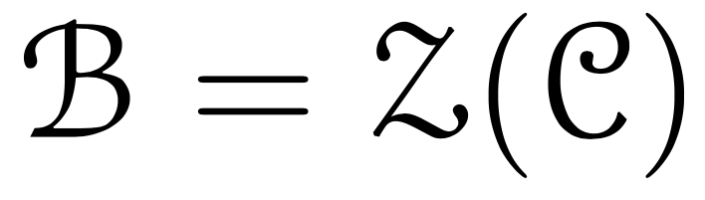
Topological Order
Drinfeld center of input unitary fusion category → modular tensor category (MTC) (braided)
Notations: , simple objects = anyons = a, b, c, …
Example: Kitaev model for Dijkgraaf-Witten theories:
Notes:
Given a topological phase, its topological order is given by MTC
In our case, consider “doubled” theories

Slide 7
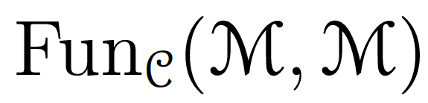

Indecomposable Modules
Definition: Let be a monoidal category. A (left/right) module category is a category with an exact bifunctor such that has a (left/right) -action
is indecomposable if it is not the direct sum of two such categories (that are nontrivial)
Claims: (Kitaev and Kong, 2012)
  Gapped boundaries in topological order indecomposable modules over
  Elementary excitations are simple objects in

Slide 8
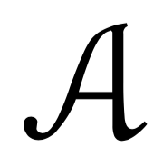

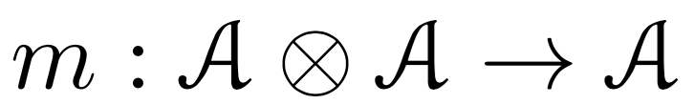


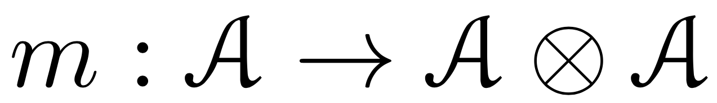
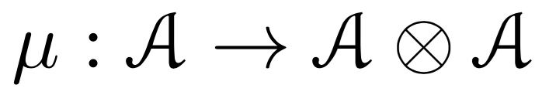
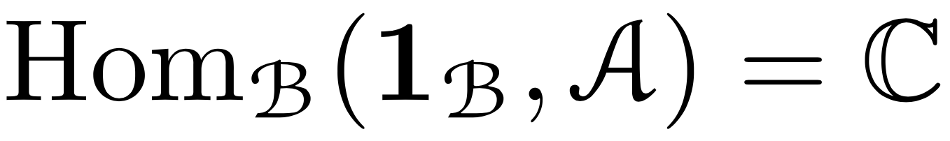

Lagrangian Algebras
Definition: A Lagrangian algebra in a MTC is an object with a morphism such that:
  is commutative: equals
  is separable: admits a section that is an ( , )-bimodule
  is connected, i.e.
  The Frobenius-Perron dimension (quantum dimension) of satisfies
Notes:
Indecomposable modules not necessarily simple to find, examine Lagrangian algebras as alternative
Satisfy 1-3 → symmetric, special Frobenius algebra
Note: maximal dimension that satisfies 1-3

Slide 9


Lagrangian Algebras
Theorem: Indecomposable modules of Lagrangian algebras in (Ostrik)
Find Lagrangian algebras → find gapped boundaries!
Two Propositions: Write , then:
  n_{s} ≠ 0 → s must be bosonic
  For all a, b
Notes:
In this way, for physicists, a gapped boundary is a collection of bulk bosonic anyons that can condense to vacuum on the boundary; this collection is described mathematically by a Lagrangian Algebra
Using the Lagrangian Algebra or Indecomposable Modules, one can find all the properties of the boundary excitations

Slide 10
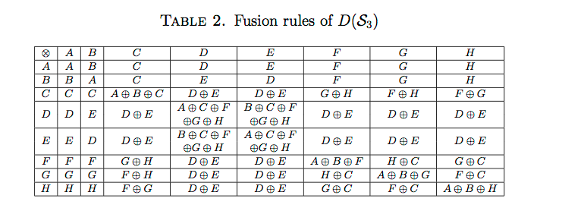
Lagrangian Algebras
Example: Find all Lagrangian algebras of D(S₃)

Slide 11
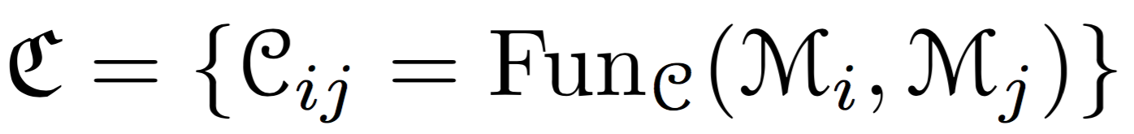
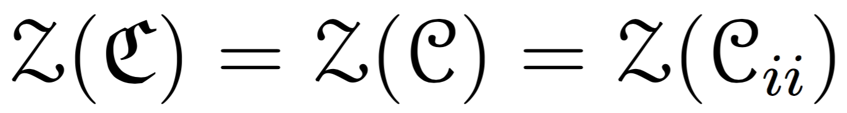
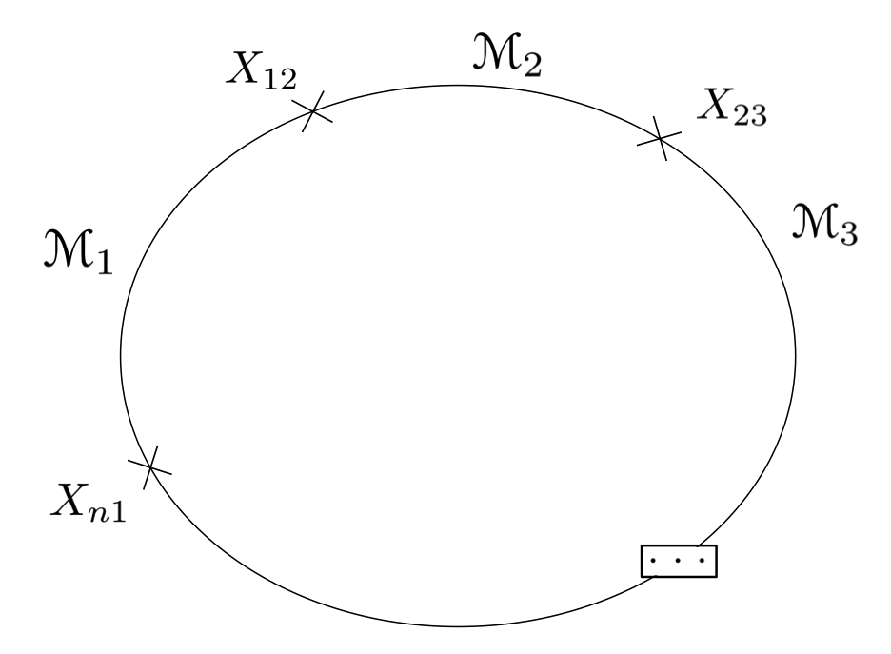
Boundary Defects
Multi-fusion category construction:
Morita equivalence (Chang et al., 2015):
Fusion and braiding (braid in doubled category)
Notes:
Because of this Morita equivalence, you can fuse and braid boundary defects with themselves or with bulk anyons.

Slide 12
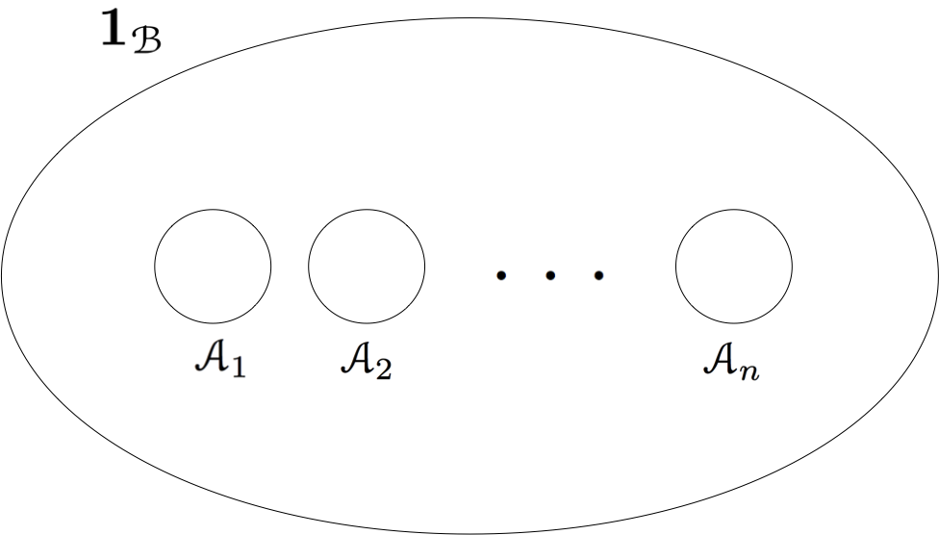
Ground State Degeneracy
Algebraic model: n holes, assume total charge vacuum

Slide 13

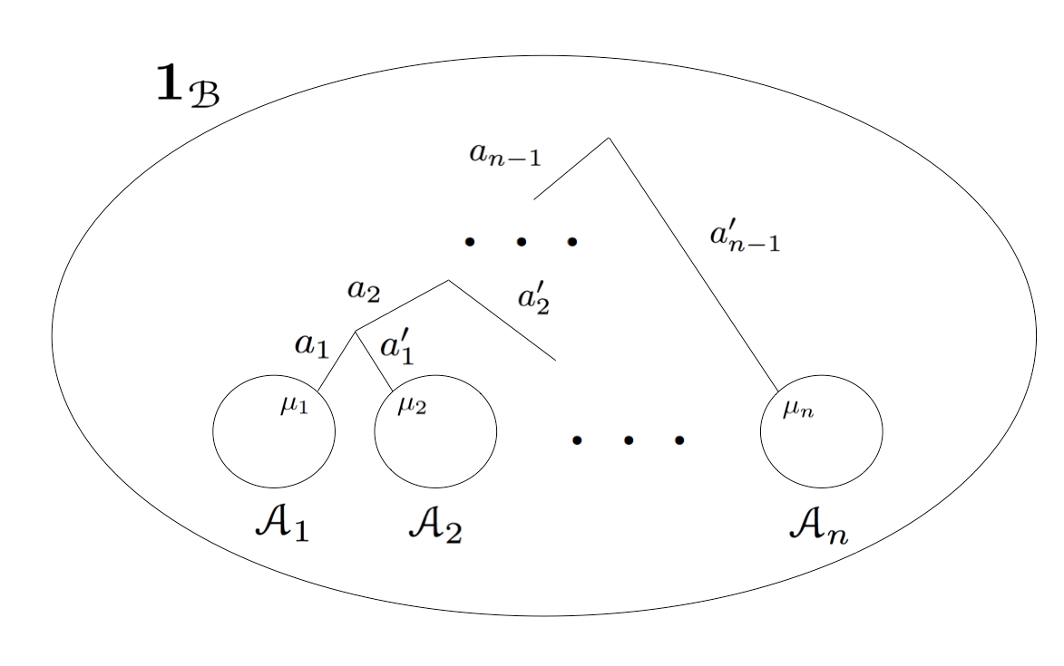
Ground State Degeneracy
Ground state:
Notes:
Note edges have to be directed in general

Slide 14
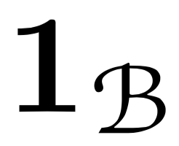



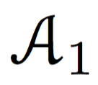
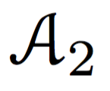
Qudit Encoding
Qudit:

Slide 15
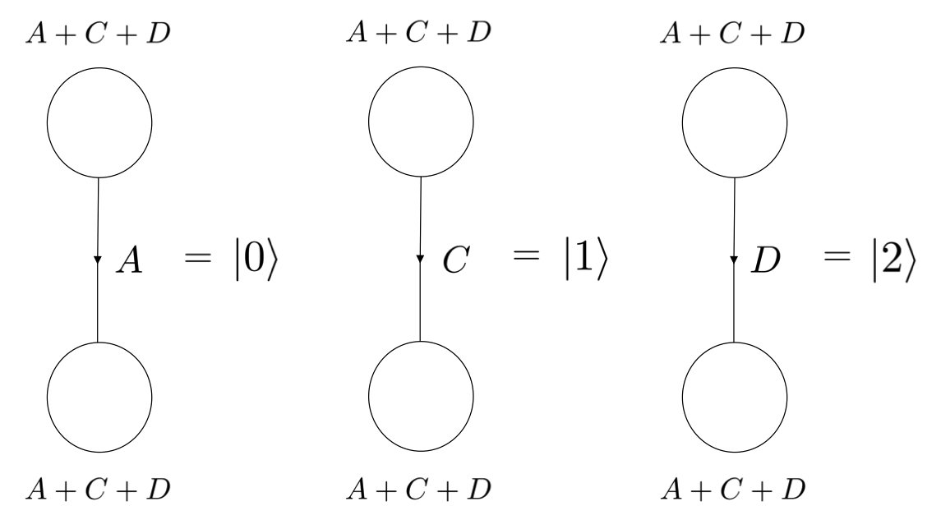
Qudit Encoding
Example: D(S₃)

Slide 16
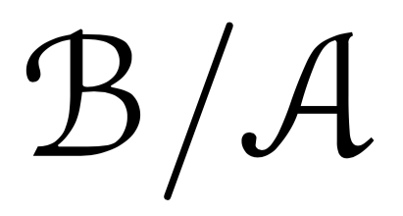

Condensation
Definition: Let be a tensor category, let be an object of . The quotient category is the category s.t.:
  The objects of are the same as the objects of
  The morphisms of are given by
Notes:
Physically, condensation is the process of a bulk anyon excitation coming to the boundary
Mathematically, described by a “quotient” procedure
Mention idempotent completion if necessary

Slide 17

Condensation
Condensation procedure:
Confined/deconfined particles
Gapped boundaries: D = Vec, =
Elementary excitations: simple objects in
Notes:
A IS THE ALGEBRA CORRESPONDING TO GB/IM M

Slide 18
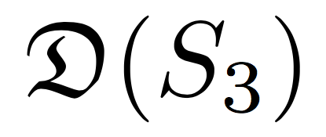

Condensation
Example: A+C+D boundary for

Slide 19
Part II: Topological Quantum Computation

Slide 20
Part II: Overview
Tunnel-a operations
Braiding gapped boundaries
Topological charge measurement
Universal topological quantum computation

Slide 21
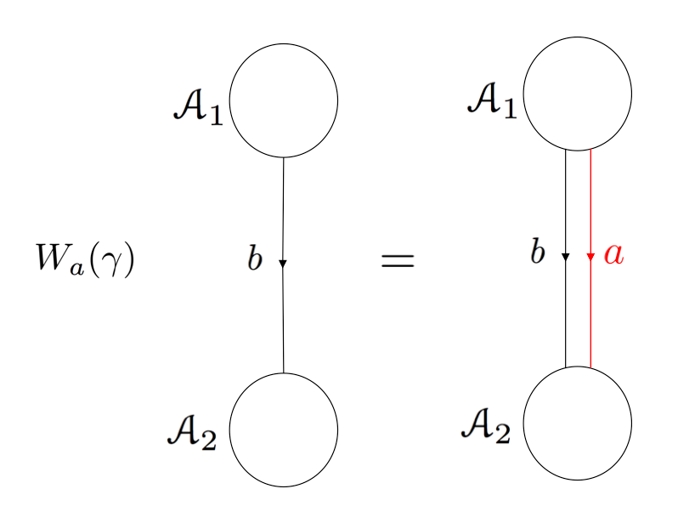
Tunnel-a Operations
Tunneling operator: tunnel a anyon from one boundary to another
Compute result in terms of original basis
Notes:
Black line indicates qudit basis, red line indicates tunneling operator
See that there are two condensation lines on each boundary now, must simplify to one line on each → require M symbols

Slide 22

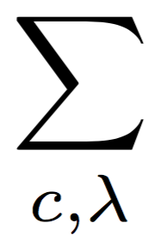
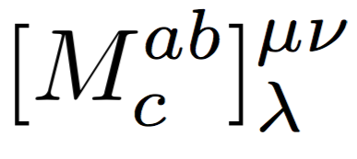



M Symbols
Map from boundary to bulk fusion space
M-3j:
Similar to F symbols or Θ symbols in the bulk
  Also satisfy pentagons, braid relations, etc.
Notes:
Pentagons: due to the fact that quotienting is a tensor functor
Can be solved for like pentagons

Slide 23
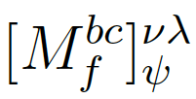
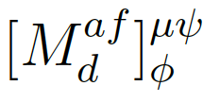

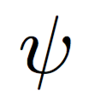


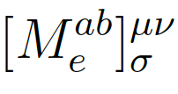
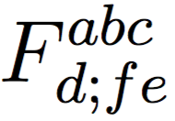


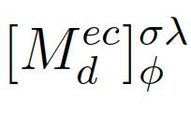
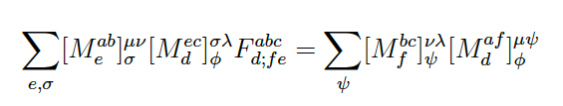
M Symbols
M-3j pentagon relations:
Notes:
This is because the quotient is a tensor functor

Slide 24
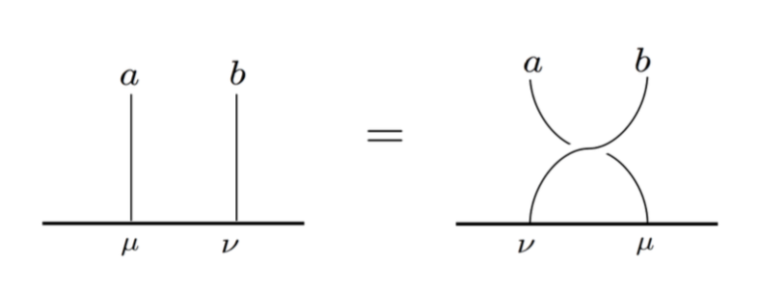
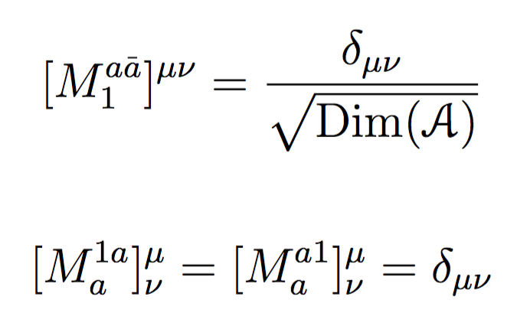
M Symbols
M-3j braid relations:
M-3j normalization:
Notes:
Braid: anyons bose condense, or A is commutative
Normalization: M is a partial isometry
Note: generalization to M-6j symbol

Slide 25
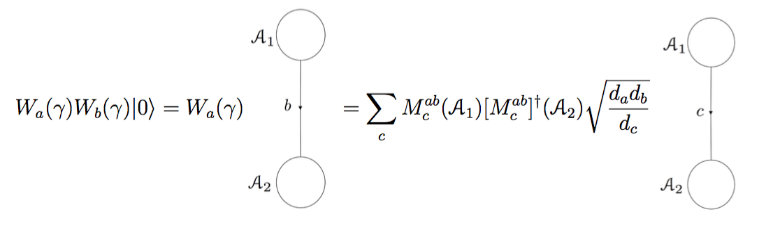
Tunnel-a Operations
Compute result in terms of original basis:

Slide 26
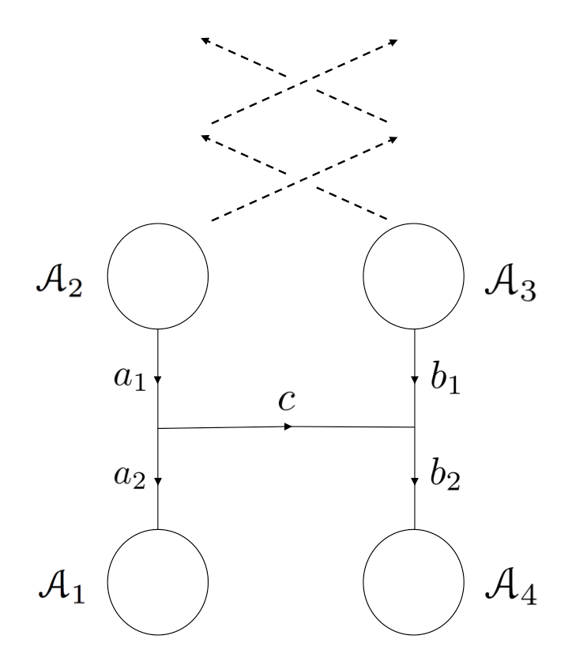
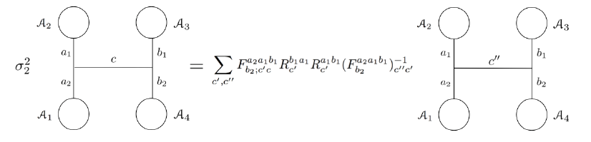
Braiding Gapped Boundaries
Braid one gapped boundary around another
Pure braid group representation
Result computed using F, R symbols
e.g.
Notes:
Note: dotted lines indicate motion, solid lines indicate qudit basis

Slide 27
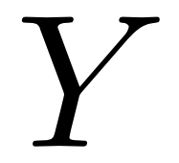

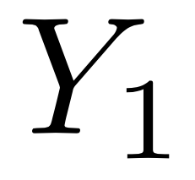

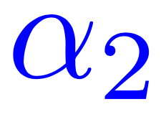
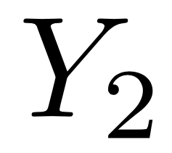
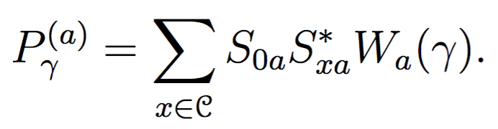
Topological Charge Measurement
  Topological charge projection (Barkeshli and Freedman, 2016)
  Doubled theories: Wilson line lifts to a loop → measure topological charge through the loop
  Example:
Generalized topological charge measurements: measure Hermitian “Wilson operators” along γ or α_{i}
Notes:
In general, could be very powerful, but we consider different sub-classes of these measurements

Slide 28
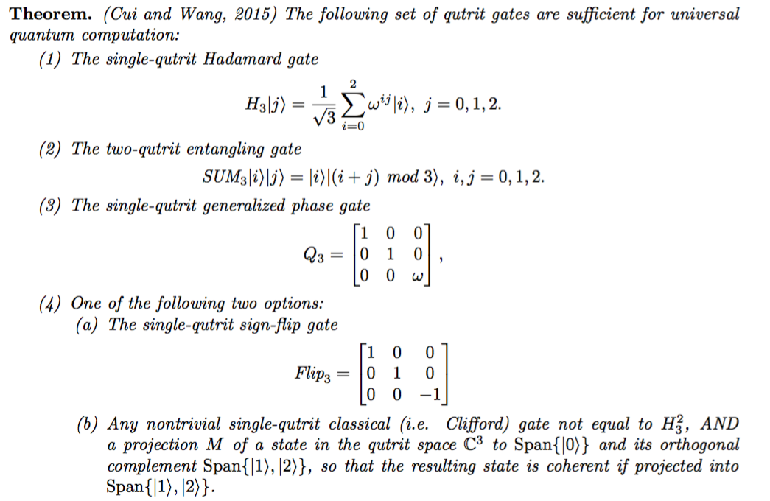
A Universal TQC Gate Set
Notes:
These can all be obtained with the D(Z_3) theory (illustrate qudit encoding, brief discussion, in backup slides or Ch. 6)
The projection required forms a positive operator valued measure with a topological charge projection (one of our sub-classes)
We believe it should be physically easier to implement, although I don’t know much about the physics (Meng/Maissam working on it)
Purely abelian → anyon braidings all projectively trivial
With coherent projection, may be one of the easiest to realize universal TQC gate set

Slide 29
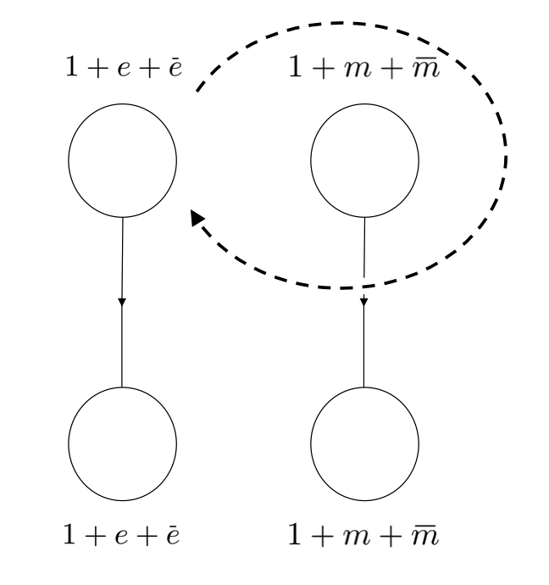
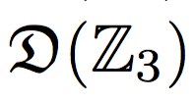
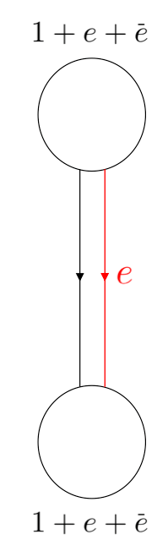
Example:
Universal gate set:
  Hadamard: Topological charge projection
  SUM₃: Braiding
  Q₃ phase gate: Topological charge projection
  Pauli-X: Tunnel e anyon
  Coherent projection: generalized topological charge measurement (require measurement 1-P, where P is a topological charge projection)
Purely abelian theory
Proposal to physically realize gapped boundaries in doubled fractional quantum Hall systems (Barkeshli, 2016)
Notes:
The projection required forms a positive operator valued measure with a topological charge projection (one of our sub-classes)
We believe it should be physically easier to implement
Purely abelian → anyon braidings all projectively trivial
Don’t know much about the physics
With coherent projection, may be one of the easiest to realize universal TQC gate set

Slide 30
Acknowledgments
Special thanks to Cesar Galindo, Shawn Cui, Maissam Barkeshli, and Alexei Davydov for answering many questions
Many thanks to Prof. Freedman and everyone at Station Q
None of this would have been possible without the guidance and dedication of Prof. Zhenghan Wang

Slide 31
Thanks!

